Slide 1
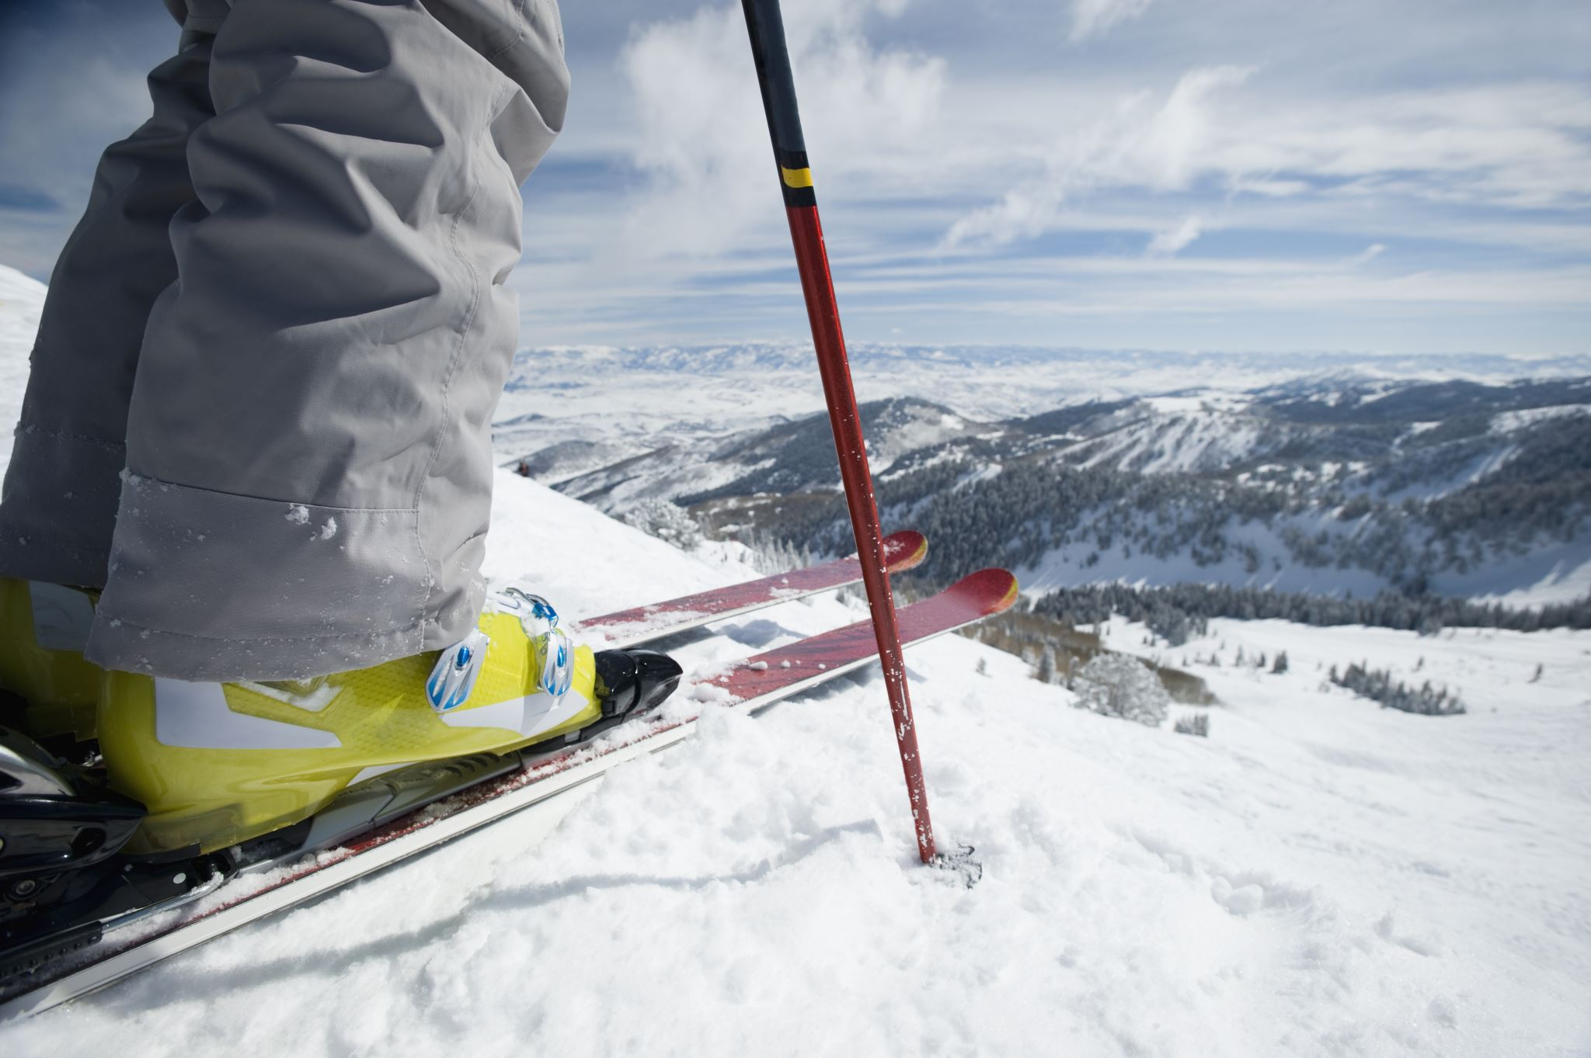
Big Mountain Resort
Marcelo Pereira
Oct/2021

Slide 2
Big Mountain Resort
Does Big Mountain Resort’s price strategy support any increase to cover the maintenance expenses of a new chair lift? Increasing the ticket price by $2 yields a projected earnings enough to cover the new expense and to create extra revenue.
4. Constraints within solution space
Weather restrictions during the season (closed access roads, storms, snow precipitation below average)
Competitors in the same area reducing their tickets to capture BMR clients
5. Stakeholders to provide key insight
CEO, Sales VP, Marketing VP, CTO, Database Manager, Head of Data Science
6. Key data sources
Data about the competitors in the market
Revenue data
Weather forecasting
1. Context
Big Mountain Resort (BMR) is a ski resort located in Montana with spectacular views of Glacier National Park and Flathead National Forest, with 105 trails. BMR has around 350K visitors yearly. Recently was installed a new chair, creating an additional operational cost of $1.5MM. We propose an increase of $2 for the ticket price to cover the operational cost of the new lift and generate extra revenue.
2. Criteria for success
Cover the $1.5MM operational cost added by the new lift
3. Scope of solution space
Increase the ticket price
Keep the 350K visitors during the season
Bonus: creation of extra revenue
Maintain the regular facilities operations
Notes:
Your client is Big Mountain Resort, a ski resort located in Montana. Big Mountain Resort
offers spectacular views of Glacier National Park and Flathead National Forest, with
access to 105 trails. Every year about 350,000 people ski or snowboard at Big Mountain.
This mountain can accommodate skiers and riders of all levels and abilities.
These are serviced by 11 lifts, 2 T-bars, and 1 magic carpet for novice skiers. The
longest run is named Hellfire and is 3.3 miles in length. The base elevation is 4,464 ft,
and the summit is 6,817 ft with a vertical drop of 2,353 ft.
Big Mountain Resort has recently installed an additional chair lift to help increase the
distribution of visitors across the mountain. This additional chair increases their
operating costs by $1,540,000 this season.
The resort's pricing strategy has been to charge a premium above the average price of
resorts in its market segment. They know there are limitations to this approach. There's
a suspicion that Big Mountain is not capitalizing on its facilities as much as it could.
Basing their pricing on just the market average does not provide the business with a
good sense of how important some facilities are compared to others. This hampers
investment strategy. You are part of a new data science team brought in to implement a
more data-driven business strategy. The business wants some guidance on how to
select a better value for their ticket price. They are also considering a number of
changes that they hope will either cut costs without undermining the ticket price or will
support an even higher ticket price.
Review the last paragraph of the overview and generate ideas about how to
increase revenue for the resort. Once you have an idea or two, use the data overview
provided below to determine if your idea can be evaluated and supported by these data.
Keep in mind that this data contains information from 330 resorts in the US that can be
considered part of the same market share and we have these same data columns for
Big Mountain Resort as well.
Region
Vertical drop / LongestRun / Skiable area / Average Snowfall / NightSkiing
Chairs
Runs (trails)
Terrain parks
Hypothesis: Create a Hypothesis with an emphasis on SMART principles. (S – Specific, M – Measurable, A – Achievable, R – Realistic, T – Timebound). If you cannot do this, you do not have a good grasp on the business problem.
Context: With context, we have clearly identified the problem at hand and have elucidated on how our initiative may solve this problem, alongside the commercial implications this will have on the business.
Criteria for Success: Clearly defining the criteria for success ensures that the scope of your work is clearly defined and understood. Otherwise, if this isn’t defined – your work will never end which will result in mismatched expectations.
Scope of Solution Space: Scoping out the solution space ensures that the business initiative is SPECIFIC for a certain segment or area. This prevents solutions that have been developed being scaled and applied for all other business units that the solution may not be responsible or scalable for.
Constraints within Solution Space: Looking forward, what are the foreseeable problems we are likely to encounter? Could this be stakeholder resistance? Could this be we don’t have access to the right data?
Stakeholders to provide key insight: Who are the people I need to speak to, to get the answers I need for my data analysis?
What key data sources are required?

Slide 3
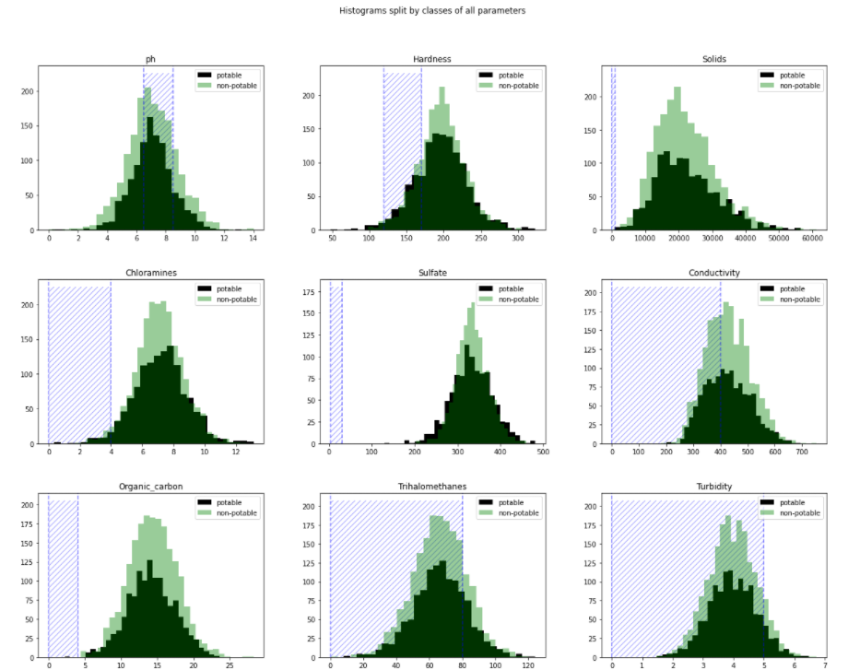
Exploratory data analysis - distribution
Exploratory data analysis raised some concerns about the data distribution overlapping for potable and non-potable
Data - basics
Target variable: potable and non-potable
9 numeric features (physical properties of water)
3276 entries (water bodies)
Missing values:
Sulfate - 781 entries (23.8%)
pH - 491 entries (15.0%)
Trihalomethanes - 162 (4.95%)
Distribution:
Potable and non-potable overlapping
Same means and interquartile distances
Outliers: present but not significant
Contoso Suites

Slide 4
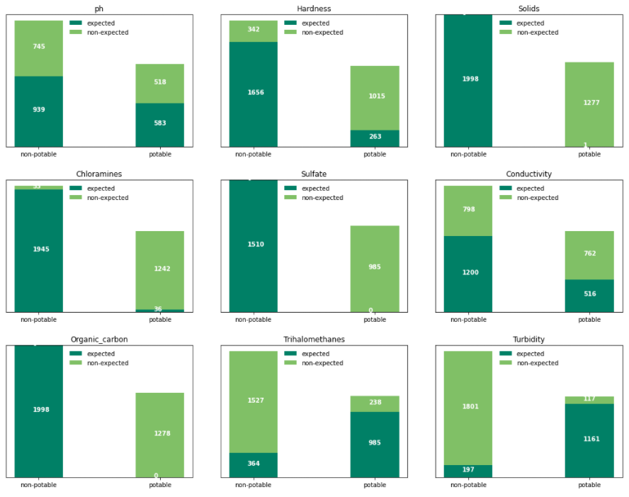
Target – potable and non-potable classification
Another aspect that seems off in the data is the correctness of the classification considering the expected values
Classification correctness
Data classification is not aligned to the WHO ranges for each parameter
Inconsistency present in all parameters and for potable and non-potable classes
Assumption: classification based on consumption in areas without alternatives

Slide 5
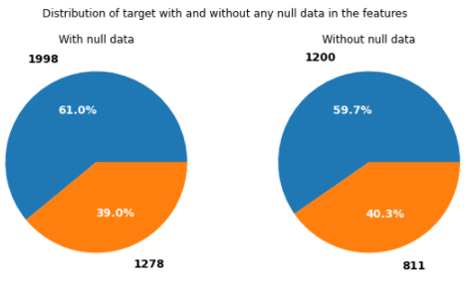
Modeling – data treatment
Missing values removed without any loss
Missing values
Data treatment
Isolate 30% of resorts for independent validation
(“test set”)
• Do following for both Linear Regression and
Random Forest
• For each set of evaluated model parameters
• Train model on 80% of remaining 70% of data, predict on
held-out 20%
• Pick params with highest correlation between actual and
predicted AdultWeekend ticket price for held-out 20%
• With best-params model, predict prices for independent
30% test set
• Select model with lower average prediction error
Missing data removed:
1265 rows excluded
2011 for the model data
No change in the target distribution
Training set:
70%
Testing set:
30%

Slide 6
Classifier, sampling, & scaling
6 classifiers with exploration of the parameters, 2 sampling methods, and 3 scaling techniques
Classifier:
Logistic Regression (Logit model): models the probability of well-defined classes or events (categorical) that can be binary or linear. Classification is the main application of this model.
K Nearest Neighbors (KNN): uses the distance between the values to group them, assuming that the data is similar when close.
Decision Tree: creates a set of rules to make the decision. These rules are evaluated and based on the decision, and you move to the following node till you reach the final classification (leaf).
Random Forest: consists of many individual decision trees that operate as an ensemble.
Ada-boost or Adaptive Boosting is an ensemble boosting classifier proposed by Yoav Freund and Robert Schapire in 1996. It combines multiple classifiers to increase the accuracy of classifiers.
XGBoost stands for eXtreme Gradient Boosting, which is a boosting algorithm based on gradient boosted decision trees algorithm.
Each model tested a set of parameters to define the best result.
Train/test sets sampling:
Random
Stratified
Results:
Random sampling led to slightly more accurate models than the Stratified.
Data scaling:
StandardScaler
MinMaxScaler
RobustScaler
Results:
No impact on the performance.
Linear regression best model
• Average price prediction error in test set +/- $11.79
• 8 features used
• empty inputs replaced by median
• Random forest best model
• Average price prediction error in test set +/- $9.54 (better)
• n_estimators = 54
• empty inputs replaced by median

Slide 7
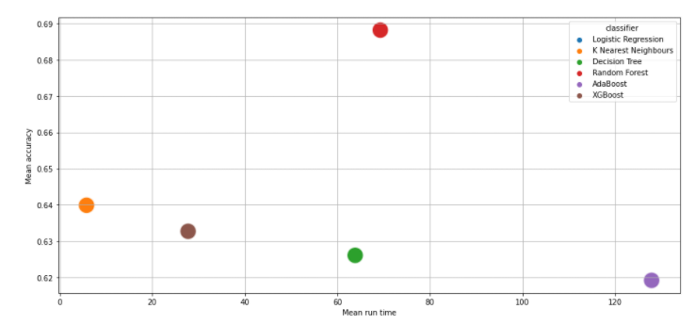
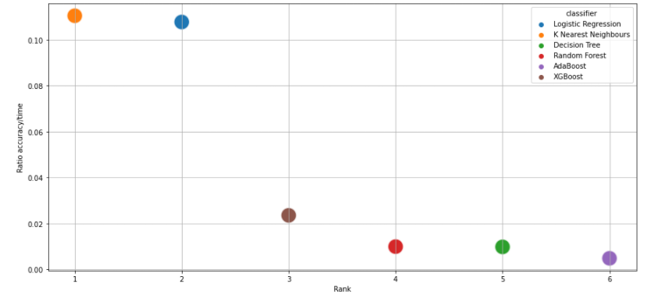
Modeling - results and analysis
Random forest is the winner evaluating the accuracy.
Accuracy
Ratio accuracy / run time
Refit random forest model on all data except Big Mountain
• same parameters as earlier
• Average price prediction error +/- $10.39
• Based on 5-fold cross validation
• Predict Adult Weekend ticket price with current facilities: $95.87
• Current price: $81
Random Forest
Random sampling
MinMaxScaler scaling
Accuracy 70%
Run time: 70 sec (training)
Parameters: ’min_samples_leaf’: 2 and ‘n_estimators’: 500
KNN
Accuracy (mean): 0.64
Faster run time does not justify the selection of this model with lower accuracy, once Random Forest run time is only 70 seconds.

Slide 8
Summary and conclusion
Models performed acceptably but data quality must be the considered carefully to adopt the model.
Considerations
Conclusion and alternatives
Price-vs-facilities model predicts market support for adult weekend ticket price of $96
(+/- $10) without impacting ticket sales
• Current price is $81
• Extra $1.99/ticket value if boost vertical drop by 150ft.
• Price boost yields +$3.5M revenue, vs $1.54M extra lift operation costs
• Additional snowmaking in support of this doesn’t add perceived market value
• Closing 10 least-used runs reduces modeled ticket price by $1.81
• This ticket price drop reduces revenue by $3.2M
• Cost savings ??
• Increasing longest run length is revenue neutral by model
Used same model to predict competitive ticket price if alter facility
assets like
• number of open runs
• available vertical drop
• longest run length
• total snowmaking acres
conclusion
Since current ticket price appears undervalued, increasing ticket price
is reasonable.
• Marketing increased vertical drop should easily justify increasing
ticket price by at least $2.
• Big Mountain predicted ticket price (and thus revenue) does not
change if offset the reduction of 10 runs with additional vertical drop
from a new lift. Change in profitability depend on relative operating
costs of new lift vs maintaining 10 least-used runs.
11

Slide 9
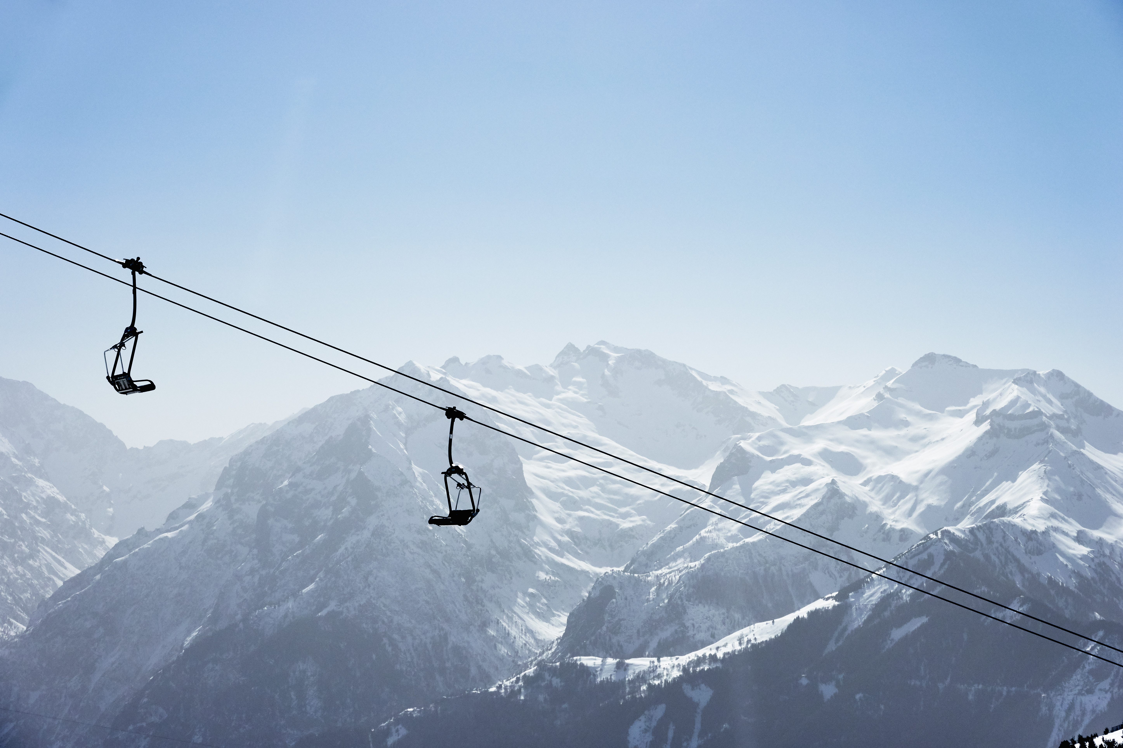



Contact:
Marcelo Pereira
https://www.linkedin.com/in/marcelo-alves-pereira/
map_fm@yahoo.com

Slide 10
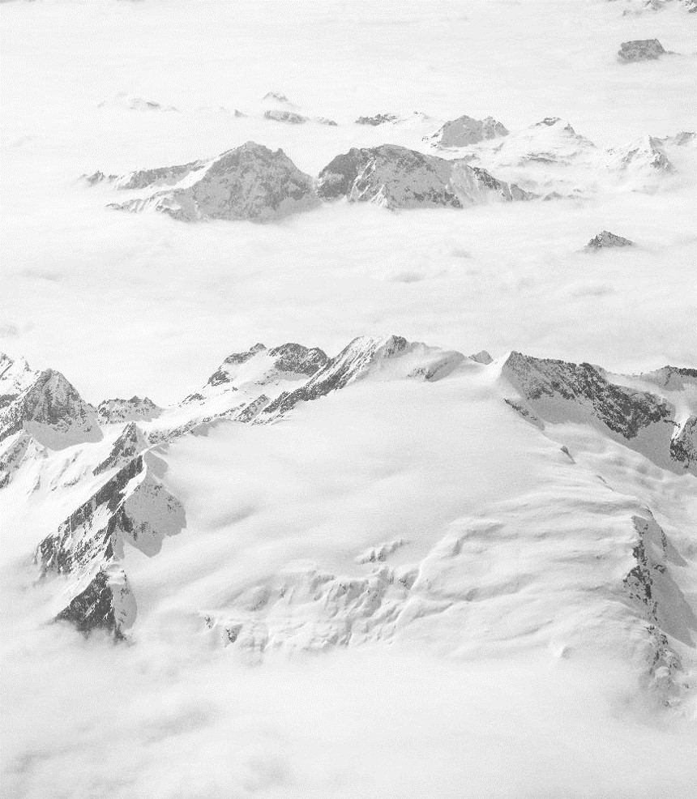
Recommendations and Key Findings
Random Forest Regression Model
Big Mountain currently charges $81.00 adult weekend ticket price
Model predicts that Big Mountains current ticket price should be $95.87
Improvement scenario add a run, increasing the vertical drop by 150 feet, and installing additional chair lift
Increase ticket price by $8.61
Season profit increase of $15,065,471
Ticket price reduction is the same for cutting 3-5 runs -$0.75

Slide 11
The Model
Random Forest Regression Model
We divided the data 70/30 for training and test datasets
We created two models using the training dataset
Linear regression
Random Forest regression
Mean absolute error of ticket price predictions
Linear Regression $11.79
Random Forest $9.65
Mean as predictor $19.13
Predictions using the Random Forest model have lower error than the other models

Slide 12
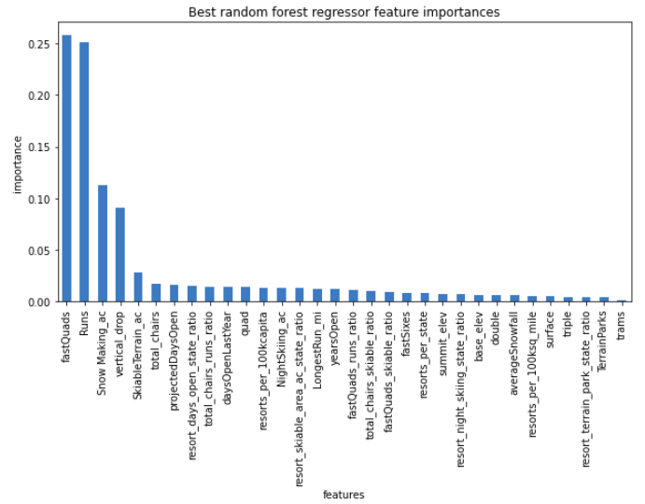
Key Ski Resort Features
Which ski resort features are important for setting ticket price?
Features used by the model to predict ticket price
fast quads
number of runs
snow making acres
vertical drop
skiable area

Slide 13
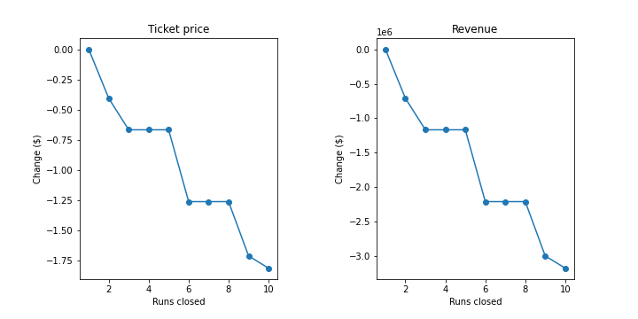
Closing Runs
How would closing ski runs impact the Big Mountain’s ticket price?
Predicted ticket price change
Closing 1 run no change
Closing 2 runs a < -$0.50
Closing 3-5 runs plateaus < -$0.75
Closing 6-8 runs plateaus < -$1.25

Slide 14
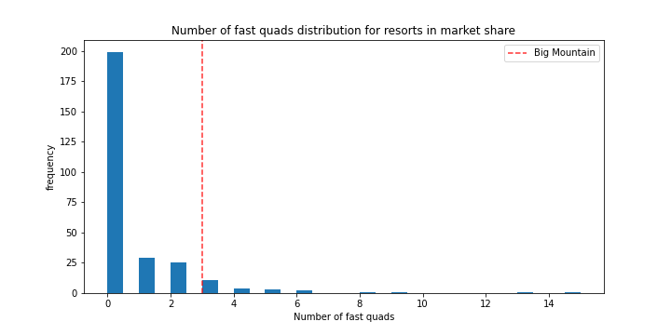
Big Mountain’s Standing
How do the features of Big Mountain compare to other resorts? Can we really justify charging more?
Number of fast quads
Big Mountain = 3

Slide 15
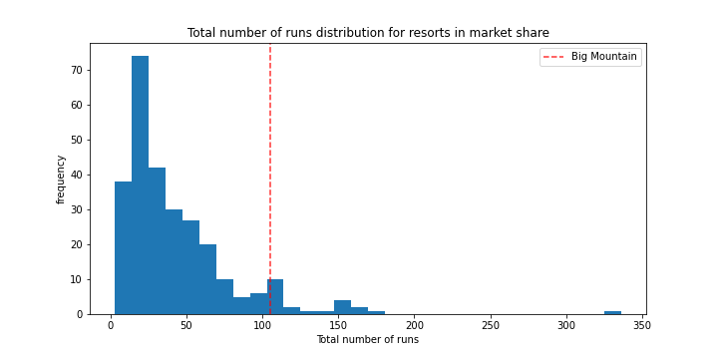
Big Mountain’s Standing
How do the features of Big Mountain compare to other resorts? Can we really justify charging more?
Runs
Big Mountain = 105

Slide 16
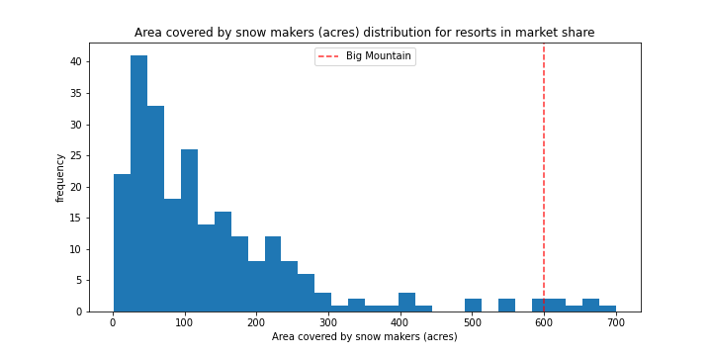
Big Mountain’s Standing
How do the features of Big Mountain compare to other resorts? Can we really justify charging more?
Area Covered by Snow Makers
Big Mountain = 600 acres

Slide 17
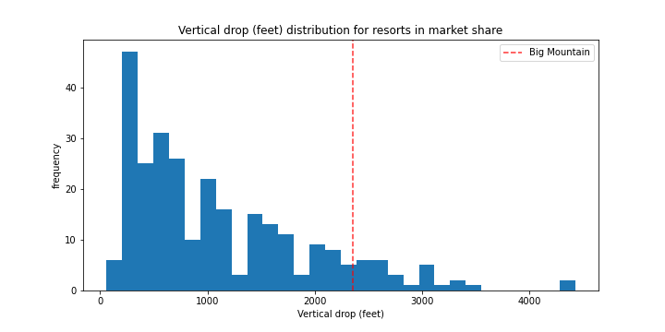
Big Mountain’s Standing
How do the features of Big Mountain compare to other resorts? Can we really justify charging more?
Vertical Drop
Big Mountain = 2,353 ft

Slide 18
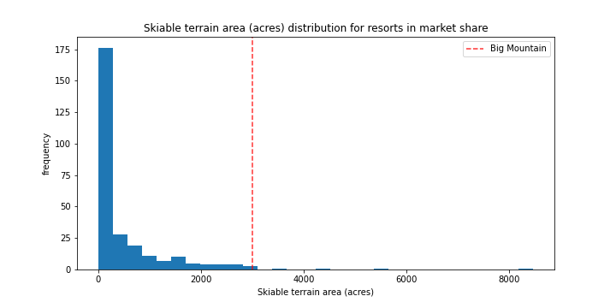
Big Mountain’s Standing
How do the features of Big Mountain compare to other resorts? Can we really justify charging more?
Skiable terrain
Big Mountain = 3,000 acres

Slide 19
Conclusions
Using the average ticket price sets a lower ticket price
There are resort features that are linked to ticket price and these features should be the focus of future improvement
Big Mountain should be charging around $95.87
Increasing ticket prices is justified because Big Mountain has high values for many of the key features

